Slide 1
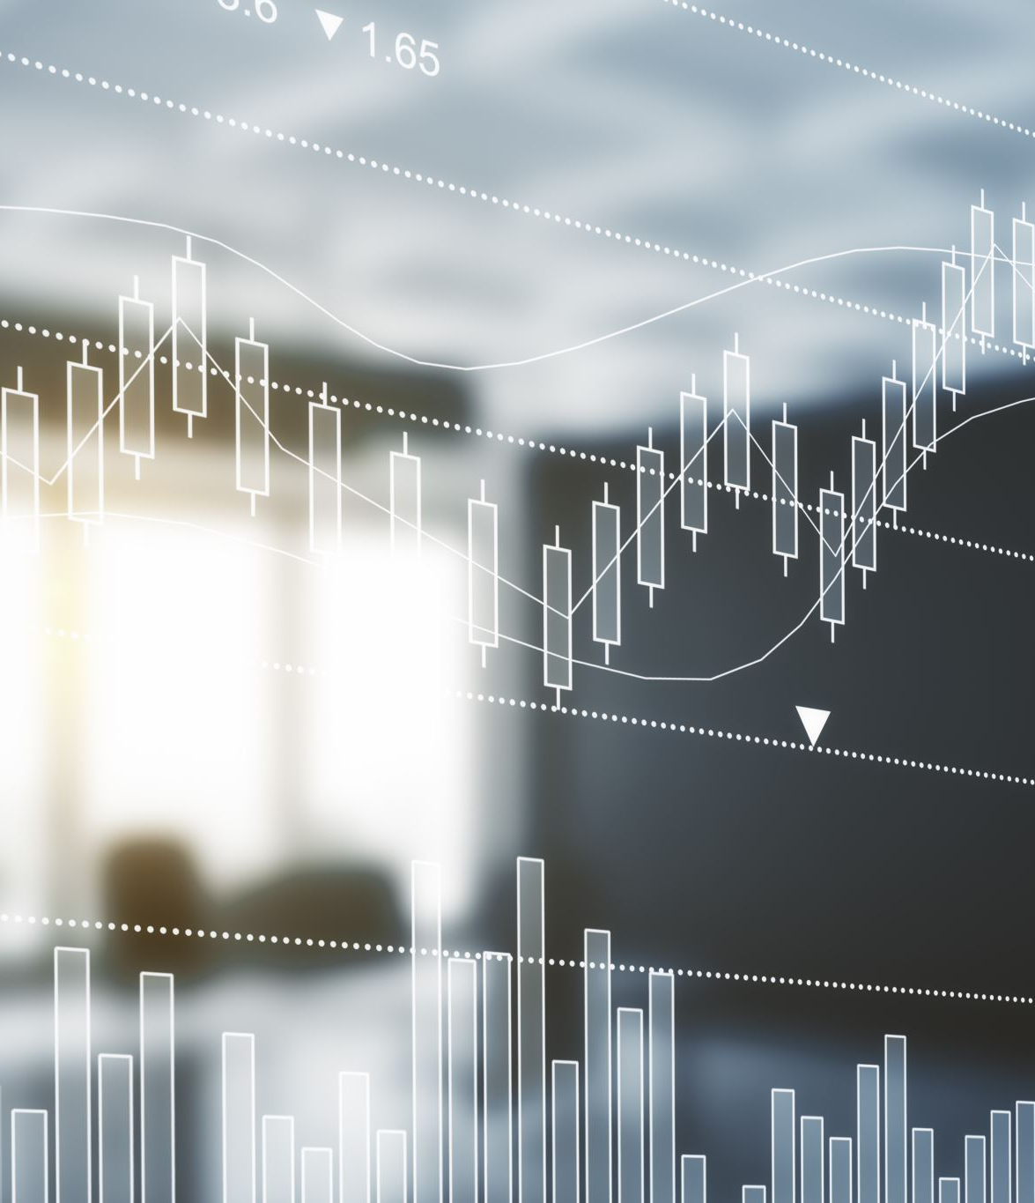
Sentiment Analysis
Course: Data Mining
Course Teacher: Dr.Salahuddin
Lab Teacher: Engr.Ramsha Mashood

Slide 2

The Jokers Moeez Ahmed Shah

Slide 3
What is TEXT?

Slide 4
DATA IS EVERYWHERE
How much data has been created since the last 2 years?
3 billion (number of google searches per day)
350 million (number of Facebook posts per day)
6000 (number of tweets per second)
29 billion (number of words in Wikipedia)
4.6 billion (number of worldwide internet users)

Slide 5
TEXT MINING
Deriving meaningful information from unstructured data.
Structure Data
Rating (A number that is easy to interpret for the computers)
Unstructured Data
Some text that needs to be preprocessed before it can be used by computers.

Slide 6

SENTIMENT ANALYSIS
Deriving sentiment from text data by using Natural Language Processing and Text mining techniques.

Slide 7
AN EXAMPLE
Shortage in oil prices is a huge celebration. (Positive sentiment)
We must produce a lot of oil in order to keep the economy running. (Negative sentiment)
Transporting oil through airplanes transport is a brilliant idea. (Positive sentiment)

Slide 8

TECHNIQUES USED
@Moeez reaaady to create sentiment analysis!!!
Normalization (ready to create sentiment analysis)
Vectorization (4 15 27 16 13)
Sentiment Model (prediction)

Slide 9

What is NORMALIZATION?

Slide 10
TEXT NORMALIZATION
Reduces randomness in a particular piece of text.
@Moeez soooo fun creating Sentiment Analysis!!!
@Moeez I create Sentiment Analysis. So fun!
Creating Sentiment Analysis is so fun with @Moeez.
Normalized:
So fun create sentiment analysis.
Create sentiment analysis so fun.
Create sentiment analysis so fun.

Slide 11
TEXT CLEARNING: Considering twitter specific
Retweets.
User tag (removing because provides no additional information).
Emojis (use emoji instead).
URLs.
Hashtags.

Slide 12
TOKENIZATION
Handling punctuations, stop words, and numbers.
Punctuation (!!!!! NO)
Stop words (I am happy) (why I am?)
Numbers ($50 good or bad?)

Slide 13
STEMMING
Is the process of reducing words to their root form.
Manager (Manag)
Management (Manag)
Managing (Manag)
But over stemming and under stemming?
Universal, university and universe?
Alumnus, alumni, and alumnas?

Slide 14

LEMMATIZATION
Serving the same meaning as stemming but makes use of word context.
Running (noun = running)
Running (adj = running)
Running (verb = run)
However, in Stemming?
All would be run, run, run.

Slide 15

WHY REPRESENTING?
Representing text numerically basically allows it to be understood by Machine Learning models.

Slide 16
TECHNIQUES
Positive/Negative (+ and – to represent).
Bag of Words (all features goes inside a bag to represent).
TF-IDF (a log based function but works really similar to bag of words).

Slide 17
MODEL SENTIMENT
Consider a tweet is first normalized, then represented into numeric format for the model to understand, now finally comes the time to train and test.

Slide 18
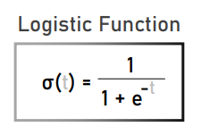
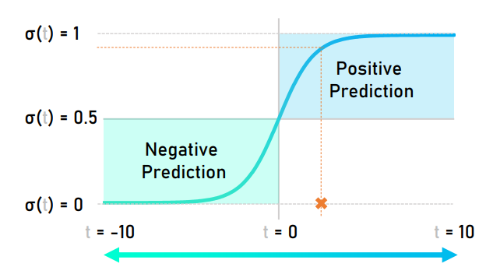
LOGISTIC REGRESSION
Use of logistic function to basically model a binary dependent variable alpha.

Slide 19

MODEL TRAINING
Train test split.
80% training data.
20% testing data.

Slide 20
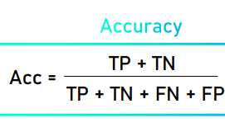
MODEL PERFORMANCE
Accuracy measure using confusion matrix.

Slide 21
ADVANCEMENTS
We will link a food application with tweeter and facebook.
The sentiment generated from these social media websites will have an impact on suggestions provided by food apps, also by other media websites (such as youtube and etc).
More to dicuss.

Slide 22

ANY QUESTIONS?

Slide 23

THANK YOU

